Slide 1
Predicting Climate Change for ClimateWins: Final Report
John Phillips
November 2024

Slide 2
Agenda
Objective
Machine Learning Options
Random Forests, Convolutional & Recurrent Neural Networks, Generative Adversarial Networks (GANs)
Thought experiments
Detecting and classifying anomalous weather events
Assessing trends in these anomalous weather events
Predicting safe areas based on climate trends
Social and Ethical Considerations
Recommendation and Next Steps

Slide 3
Objective
Use machine learning to explore the feasibility of different climate change questions:
Identifying anomalous weather patterns in Europe.
Determining if those patterns are increasing in frequency.
Generating possibilities for future weather conditions over the next 25-50 years.
Determining the safest places for people to live in Europe over the next 25-50 years.

Slide 4
Machine Learning Overview
Random Forests, Convolutional (CNNs) & Recurrent Neural Networks (RNNs), Generative Adversarial Networks (GANs)

Slide 5
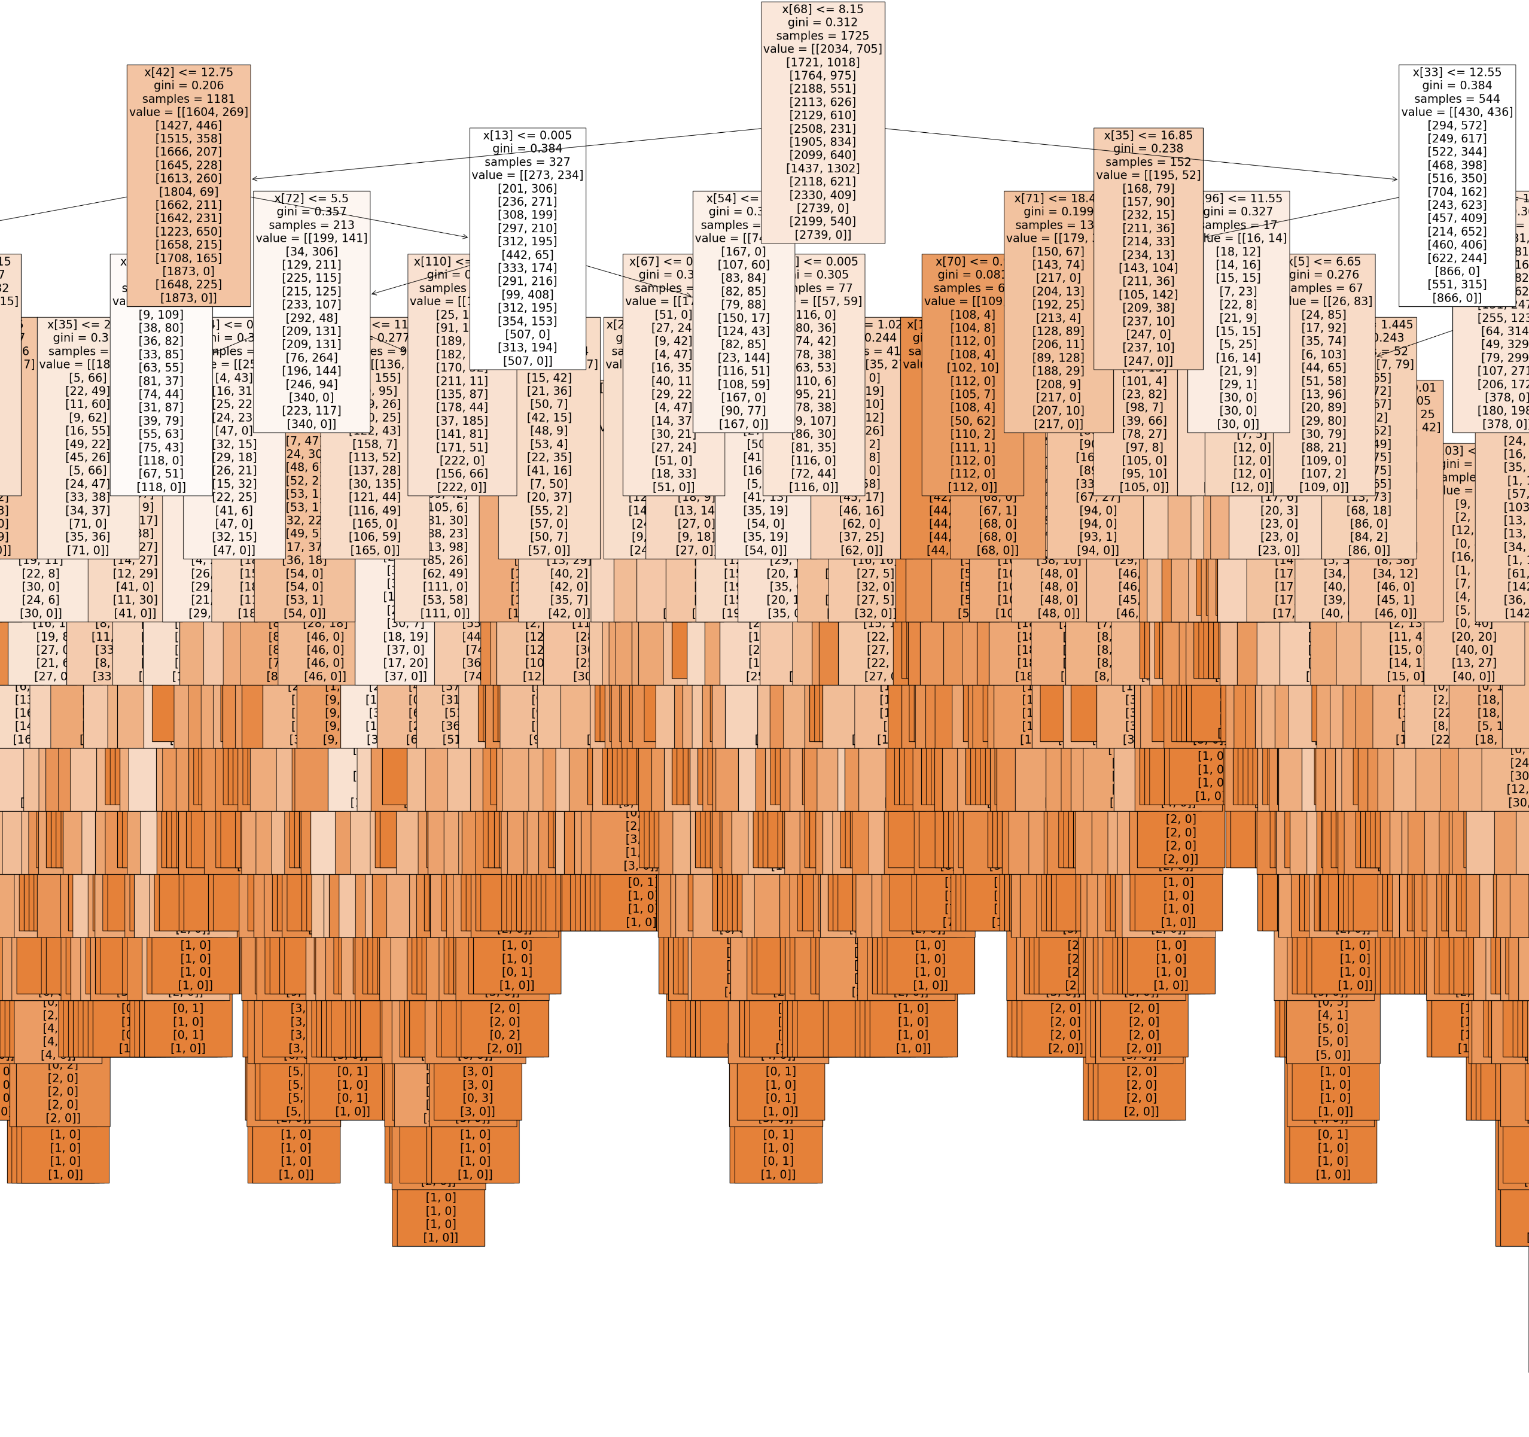
Random Forests
Collections of decision trees that together enhance predictive capacity and insights into feature importance.
RFs can identify key weather variables that signal anomalies, making them effective at classifying anomalous weather events.
They are less suited for analyzing trends over time.
A random forest for all weather stations for the 2010s

Slide 6
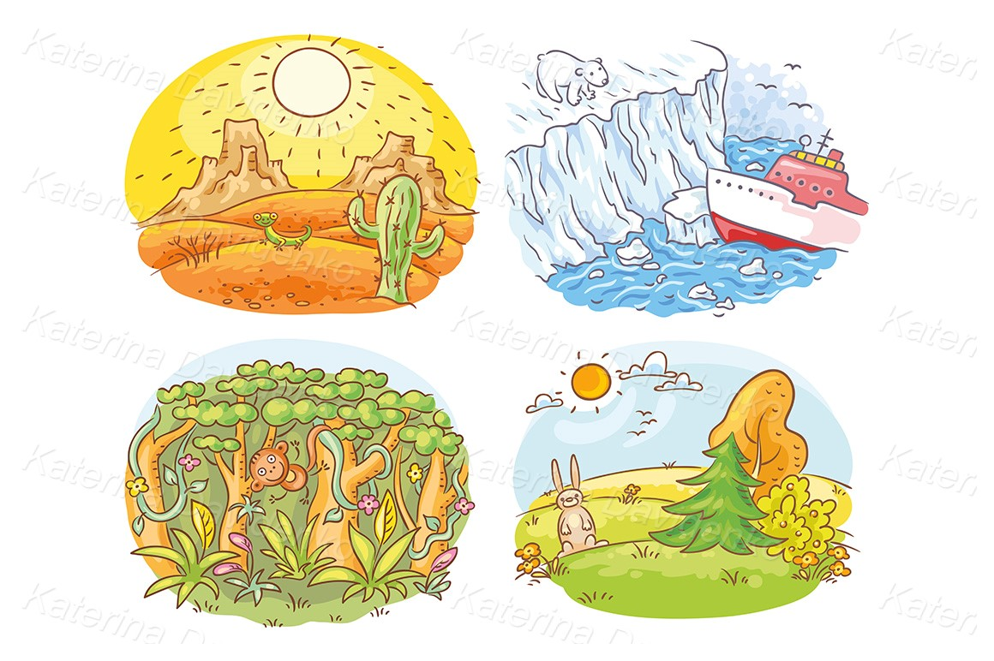
Convolutional & Recurrent Neural Networks
Deep learning models that excel in analyzing spatial climate patterns (CNNs) and assessing temporal data and climate trends over time (RNNs).
These attributes make them well-suited for detecting spatial anomalies and overall climate trends.

Slide 7
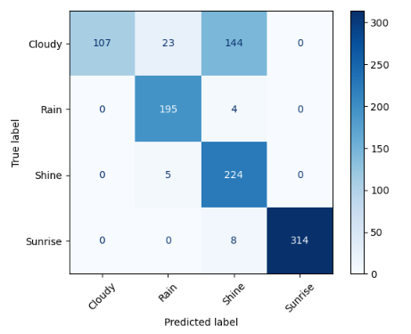
Generative Adversarial Networks (GANs)
Consist of a generator and discriminator network that work in tandem to create data mimicking real-world samples.
Useful in generating synthetic climate scenarios- including anomalous weather events.
These make GANs helpful with predicting safe areas by simulating realistic scenarios.
While the model is great with predicting 3 out of 4 weather conditions, there’s still some work to do.

Slide 8
Three Thought Experiments
Which climate question is the most feasible for us to address?

Slide 9

TE 1: Detecting and classifying anomalous weather events
Task: Understanding climate change impacts by investigating and identifying rare weather events in European regions that are incongruent with historical norms.
Approach: Utilize random forests to detect important anomaly features and use CNNs to analyze satellite imagery to understand visual patterns associated with these events.
Data Requirements: Historical regional data and regional satellite imagery.
Data Bias: Regional underrepresentation for satellite imagery or data collection for financial or other circumstantial reasons.

Slide 10
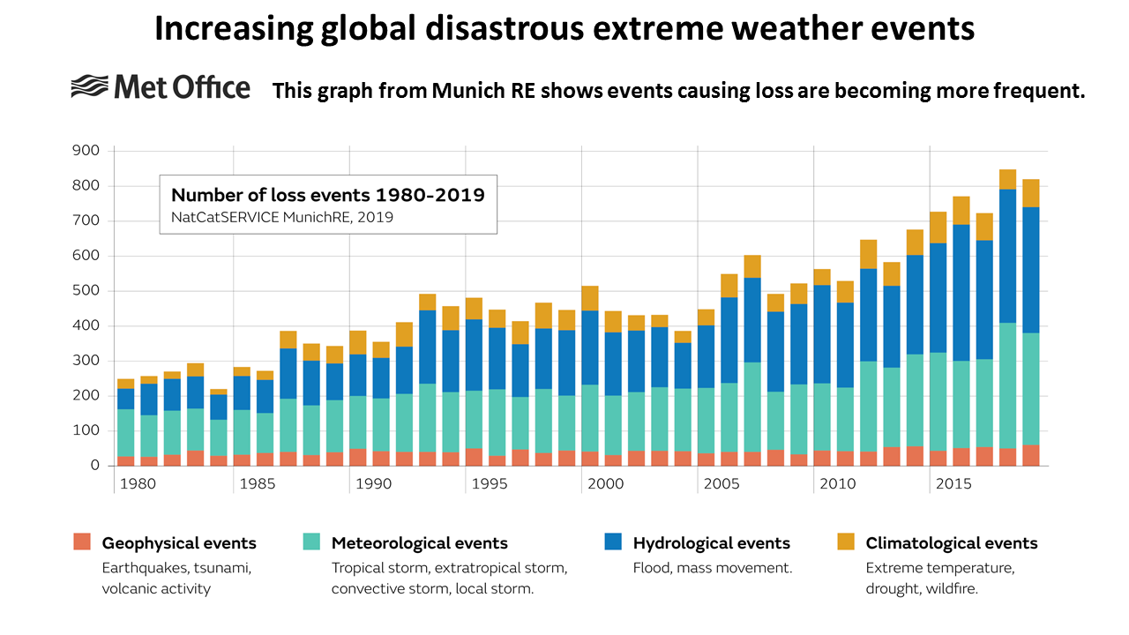
TE 2: Assessing trends in anomalous weather events
Task: Understand the rate of change of rare weather events in regional Europe to gain more insight into shifting climate behavior.
Approach: Implement RNNs to analyze sequential data and detect trends over time; use random forests to model feature importance for these events.
Data Requirements: Historical regional weather data.
Data Bias: Climate risk evaluations could be affected by regions who are underrepresented in the dataset.

Slide 11

TE 3: Identifying safe areas to live based on climate trends
Task: Uncover the safest cities or regions in Europe that are least likely to suffer from climate change in the next 25-50 years.
Approach: Use random forests to establish risky environmental features, then have GANs generate potential future scenarios for European regions.
Decision trees and KNNs can also be used for risk categorization of different regions.
Data Requirements: historical regional weather data, geospatial data, and data for city infrastructures.
Data Bias: GANs could perpetuate biases inherent in historical data.

Slide 12
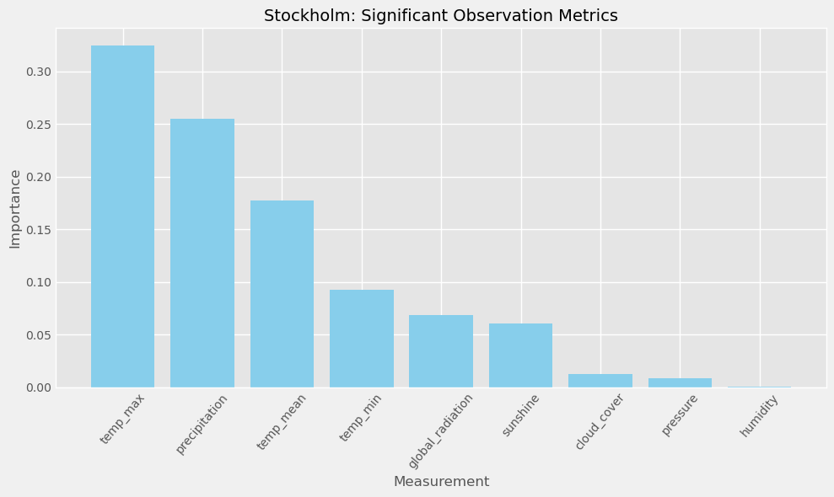
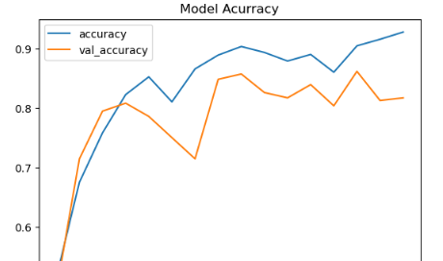
These Experiments in Practice
Using a random forest model, I found the most important variables that determine whether a day’s weather will be pleasant or not are max temperature, precipitation, and mean temperature. This held true across all regions.
Having trained CNN and RNN models to correctly predict pleasant weather days over 72% of the time across 15 different weather stations, a lot of progress has been made, but there is more work to do.
I trained a GAN to correctly classify different weather images 82% of the time.

Slide 13

Social and Ethical Considerations
Equitable information access: if one- or all- of these climate endeavors ends in us generating useful, actionable insights, it is our responsibility to disseminate this information to all corners, allowing those with less information access to make decisions if their homes are or will be affected.
Responsible communication: we also must communicate any dangers with appropriate temperance and an even-keeled demeanor, upholding transparency but also avoiding any cause for public panic.
Financial incentives: the information generated could be mishandled for financial gain (changing property values, etc.).

Slide 14
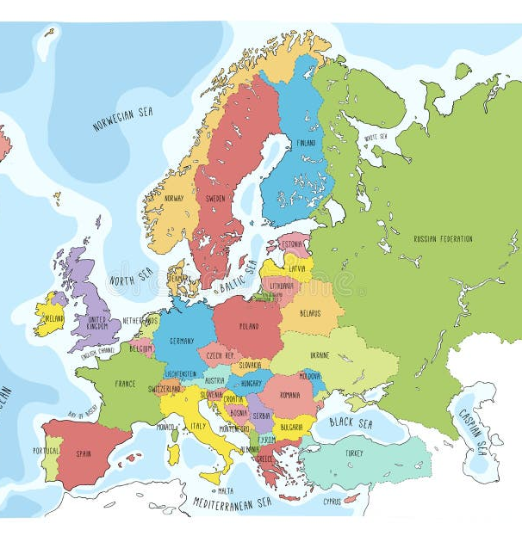
Recommendation and Next Steps
While the third option (safe areas detection) is the most ambitious, and has the most to gain, it is also the most difficult of the three to carry out accurately.
While ML continues to make leaps and bounds, I am unsure whether we are prepared now to make sufficiently clear predictions with sufficiently low error bars.
I recommend we start with the first option, which would then naturally lead into the second one.
If we can figure out the regions that are suffering from anomalous weather events, then go a step further to understand their change in frequency, we can garner a lot of actionable and practical information that will be invaluable to the continent of Europe.

Slide 15
Thank you!
I will now take any questions.
For all info on this project please refer to GitHub.

